Slide 1

Military Outreach for Service (MOS)
Lunch and Learn
July 15, 2020
Applying for Veterans Administration (VA) Disability Benefits and the Appeal Process

Slide 2
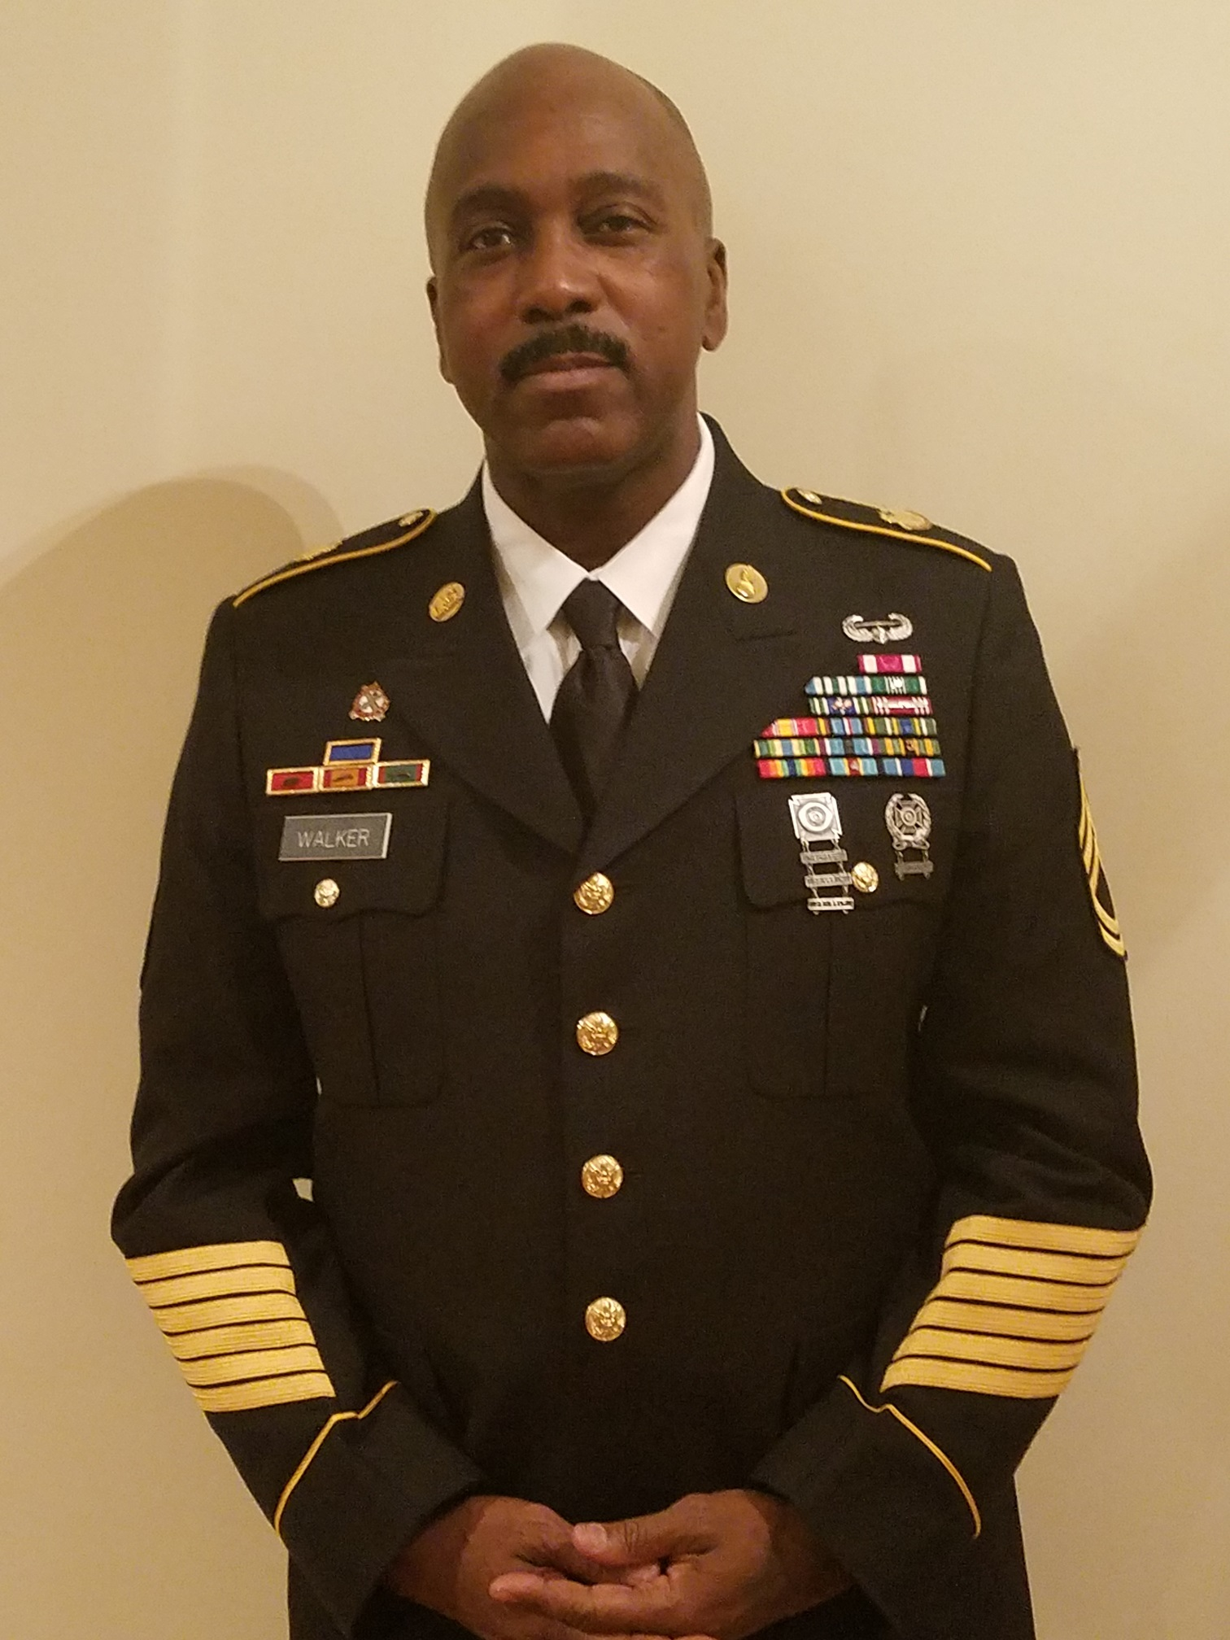
Speaker
Presented By
SFC Stanley Walker, US Army, Retired
MOS National President

Slide 3
Outline of Presentation
What to do first – Submit an intent to file
Seeking Help with Veterans Service Organizations
Using Disability Benefits Questionnaires (DBQs)
The Claim Process
The Appeal Process

Slide 4
What to do first?
Lock in the date

Slide 5
First Steps
Submit an intent to file claim – This starts the clock on one year countdown for effective date of award if approved
Gather medical documents and review specific Disability Benefits Questionnaires (DBQs)
Acquire, if applicable, bubby statements from someone who can attest to you condition or injury while in service. This can also be your spouse.

Slide 6
What is the intent to file process?
This process allows you more time to collect information to support your claim. It also protects the earliest possible effective date for any benefits resulting from your claim. The date VA receives your intent to file will be protected as your effective date. However, the correct application form must be submitted within one year.

Slide 7
Seeking Help with Veterans Service Organizations (VSO’s)

Slide 8
Where to find help – Veteran Service Organization (VSO)
The Following Organizations have Veteran Service Officers Nationwide. You do not have to be a member of these organization to use their services.
Veterans of Foreign Wars (VFW)
American Veterans (AMVETS)
Vietnam Veterans of America (VVA)
Disabled American Veterans (DAV)
Paralyzed Veterans of America (PVA)
American Legion (AM)

Slide 9
Veterans Service Officer (VSO)
A VSO representative (also known as a Veterans Service Officer) helps you with the preparation, presentation, and prosecution of claims.
State Veteran Affairs Offices can do the same
Every state provides Veteran Service Officers. They will help with VA claims, and they can help you identify benefits available from your state government. Those state benefits can be reduced property taxes, educational benefits, and more.

Slide 10
Using Disability Benefits Questionnaires (DBQs)
VA Forms 21-0960 Series

Slide 11
Disability Benefits Questionnaires (DBQs)
Disability Benefits Questionnaires (DBQs) are forms used by VA physicians when performing C&P Exams for VA Disability. The purpose of a DBQ is to ensure that the physician performing the exam records all the information needed to properly rate a disabled veteran’s conditions.

Slide 12
Disability Benefits Questionnaires (DBQs), continued
There are more than 80 different DBQs. The majority of DBQs are for entire body parts or systems, like respiratory conditions, but there are a few specific conditions, like sleep apnea, that have their own DBQ. Similarly, there are some conditions that don’t really have a DBQ that fits quite right. For these, the physician can use the closest one or not use one at all. As long as the appropriate tests are performed and the correct information recorded, a DBQ is not essential. They are merely assistive devices.

Slide 13
DBQs no longer shared w/ Public
In early 2020, the VA removed public access to their current DBQ forms (I wonder why?), but the VA-approved physicians performing the C&P Exams still have full access to the correct forms needed to conduct their exams.
Check with your VSO and or online for some sites may still have them listed. While the getting was good I saved a lot of them to share.

Slide 14
The Claim Process
1. Go to - https://www.ebenefits.va.gov/ebenefits/homepag
2. Same log-in can be use at VA.gov
3. Have all documents ready to upload to site
4. Uploaded documents you see quicker online
5. You can also mail claim in which is slower

Slide 15
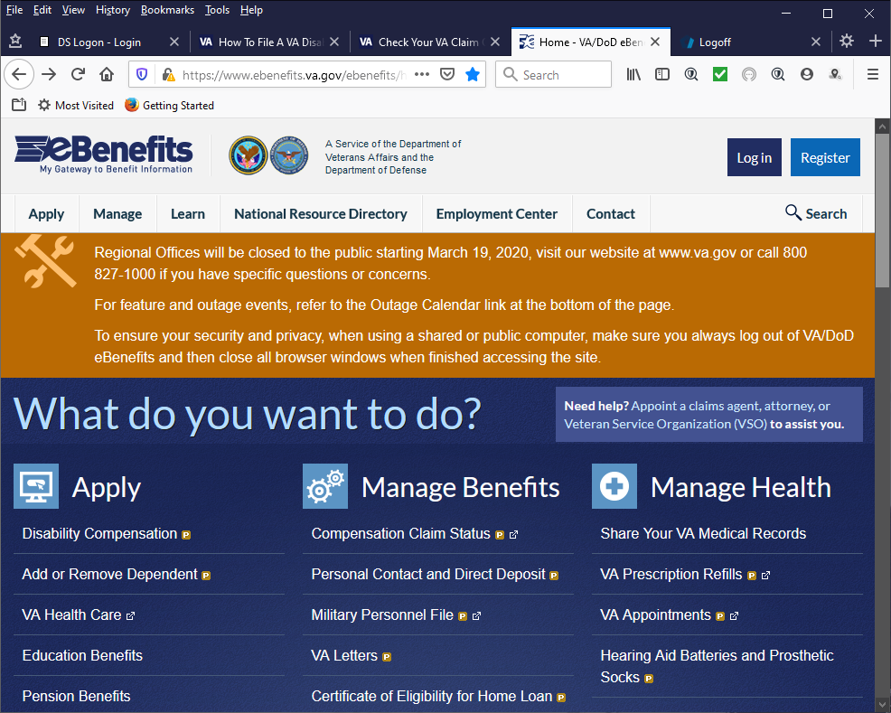
VA’s eBenefits website: Homepage

Slide 16
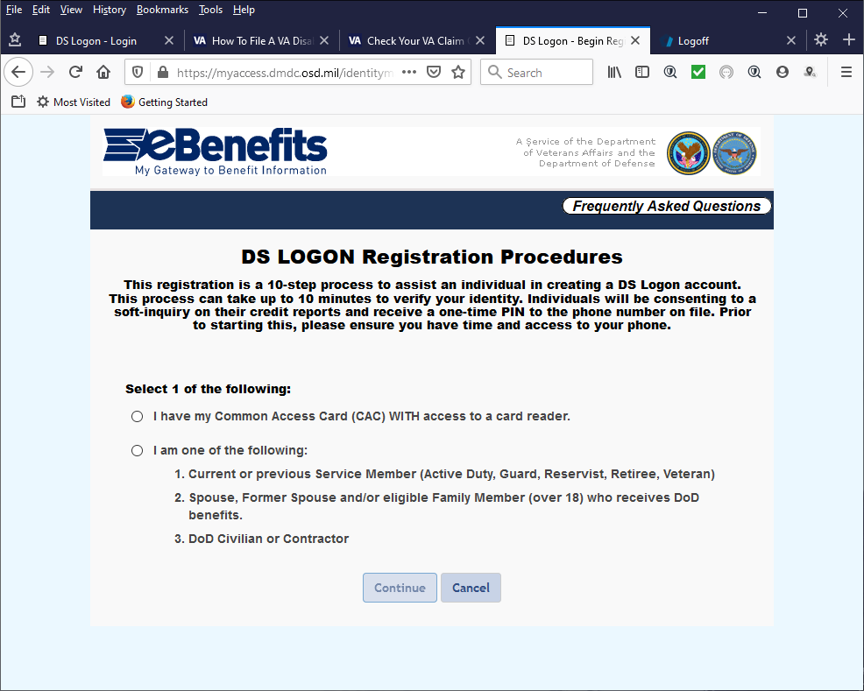
VA’s eBenefits website: Login

Slide 17
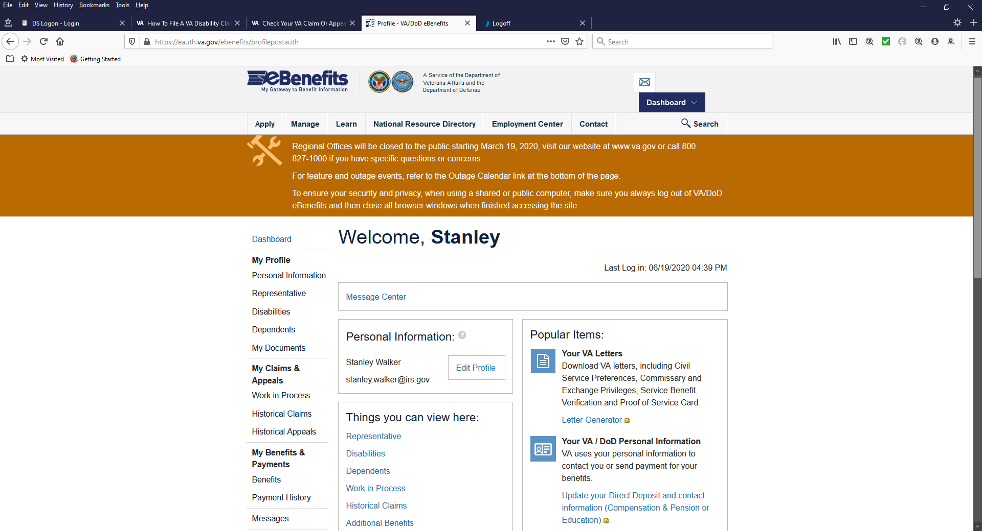
VA’s eBenefits website: Post-Login

Slide 18
File Your Claim
File your claim by mail using an Application for Disability Compensation and Related Compensation Benefits (VA Form 21-526EZ).
Download VA Form 21-526EZ (PDF)
Print the form, fill it out, and send it to this address:
Department of Veterans Affairs
Claims Intake Center
PO Box 4444
Janesville, WI 53547-4444
Or you can do in person -
Bring your application to a VA regional office near you.

Slide 19
The Appeal Process
VA decision reviews and appeals
The legacy VA appeals process has changed to the decision review process. If you disagree with a VA decision dated on or after February 19, 2019, you can choose from 3 decision review options (Supplemental Claim, Higher-Level Review, or Board Appeal) to continue your case. If you aren’t satisfied with the results of the first option you choose, you can try another eligible option.

Slide 20
The Appeal Process, continued (pt 2)
Supplemental Claim - When you choose to file a Supplemental Claim, you’re adding new evidence that’s relevant to your case or identifying new evidence for review. A reviewer will determine whether the new evidence changes the decision. To request a Supplemental Claim, fill out the Decision Review Request: Supplemental Claim (VA Form 20-0995).
How long does it take VA to make a decision? 4-5 months. VA goal for completing Supplemental Claims is an average of 125 days.

Slide 21
The Appeal Process, continued (pt 3)
Higher-Level Review, or - If you disagree with VA’s decision, you can request to have a senior reviewer take a new look at your case. The reviewer will determine whether the decision can be changed based on a difference of opinion or an error. To request a Higher-Level Review, fill out the Decision Review Request: Higher-Level Review (VA Form 20-0996).
How long does it take VA to make a decision? 4-5 months. The VA goal for completing Higher-Level Reviews is an average of 125 days.

Slide 22
Board Appeal
Board Appeal - When you choose this option, you’re appealing to a Veterans Law Judge at the Board of Veterans' Appeals in Washington, D.C. A judge who’s an expert in Veterans law will review your case. To request a Board Appeal, fill out the Decision Review Request: Board Appeal (VA Form 10182).
What are your Board Appeal options? If you select a Board Appeal, you have 3 options. VA encourage you to work with your representative to decide which of the following options is best for you.

Slide 23
Options
Option 1: Request a Direct Review - A Veterans Law Judge will review your appeal based on evidence already submitted. You can't submit evidence and can't have a hearing. The Direct Review option will take about one year for the Board to complete.
Option 2: Submit more evidence - You can submit more evidence for a Veterans Law Judge to review. You must submit this evidence within 90 days of the date we receive your Decision Review Request: Board Appeal (VA Form 10182). Download VA Form 10182 (PDF). The evidence submission option will take more than one year for the Board to complete.

Slide 24
Options, continued
Option 3: Request a hearing - You can request a hearing with a Veterans Law Judge. You can choose to add new and relevant evidence, either at the hearing or within 90 days after the hearing. Adding evidence is optional. Your hearing will be transcribed and added to your appeal file.
You can choose from 3 different ways to speak with the Veterans Law Judge:
Virtual hearing from your home
Videoconference hearing at a VA location near you
In-person hearing at the Board in Washington, D.C.
The hearing request option will take more than one year for the Board to complete.

Slide 25
Court of Appeals
After a Board decision - If you disagree with the Board’s decision, you can appeal to the U.S. Court of Appeals for Veterans Claims. You can hire an attorney to represent you, or you can represent yourself.

Slide 26

Questions?
Questions

