Slide 1
Navigating USAJOBS for a Career in the Federal Government
Donisha Hines
Matthew Solano

Slide 2
Agenda
Establishing an account
Uploading / Building a resume
Applying for positions
Upcoming events

Slide 3



Question 1
When was the last time you used USAJOBS?
  Click for - within the past year
  Click for - over a year ago
  Click for - never

Slide 4
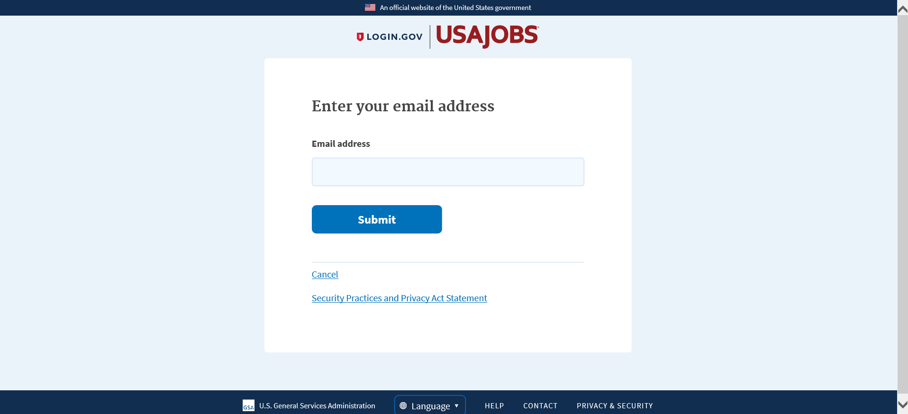
Establishing an Account

Slide 5
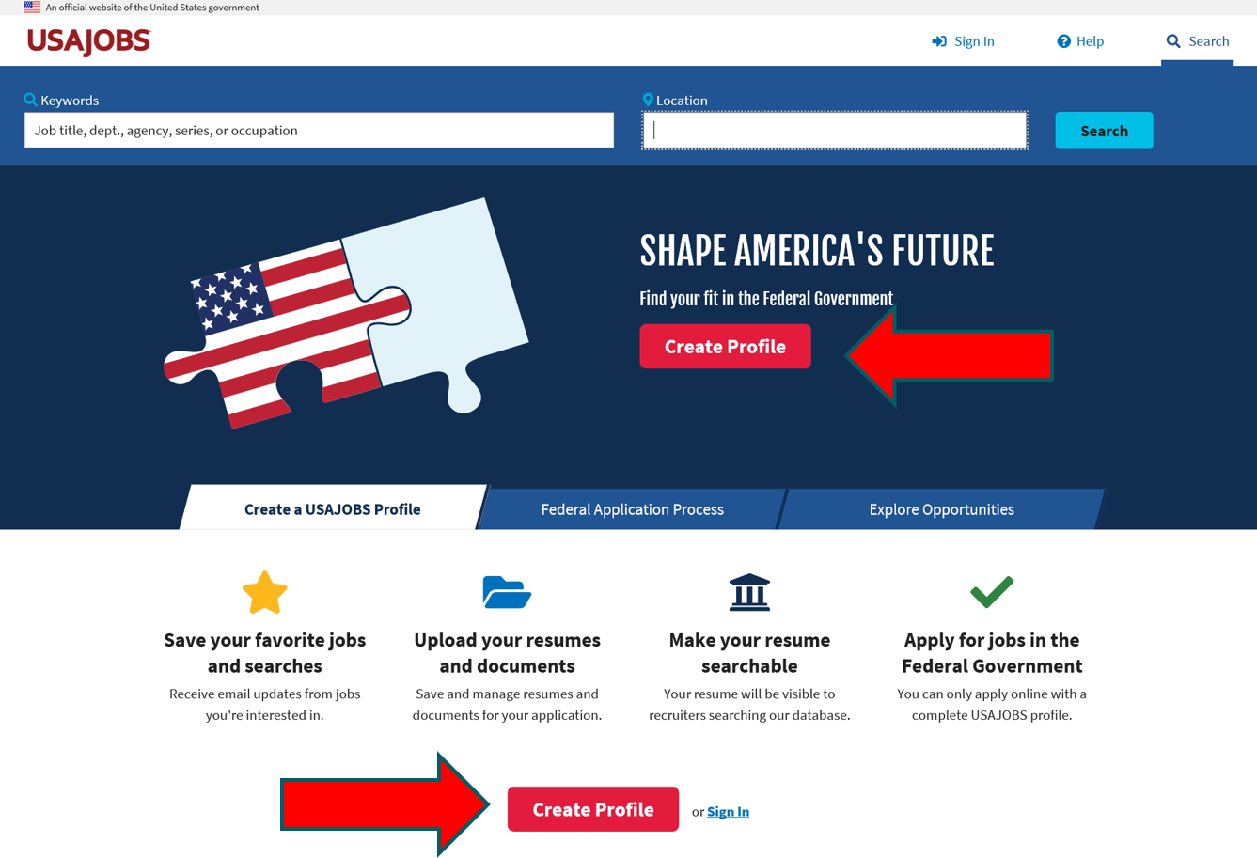
Create a profile – landing page

Slide 6
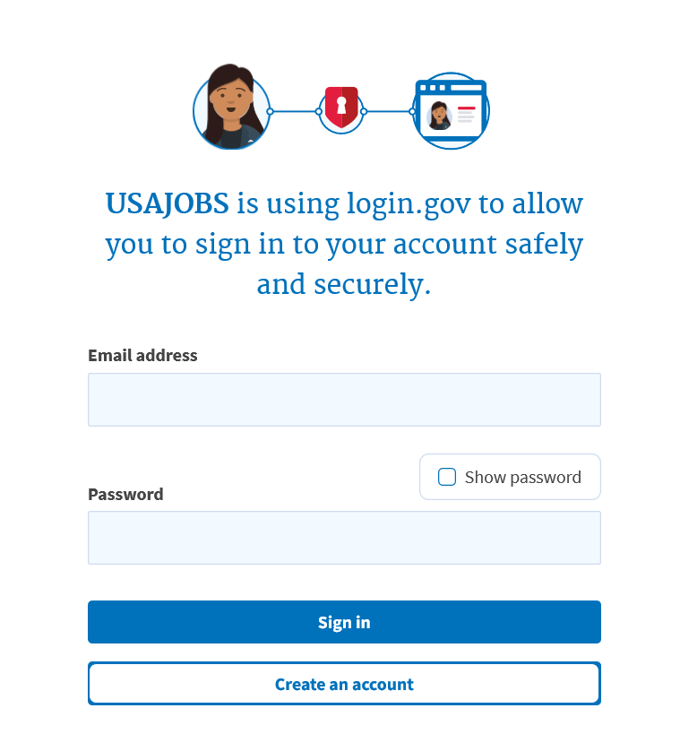
USAJOBS Account Sign-in Page

Slide 7
Step one – enter Email address

Slide 8
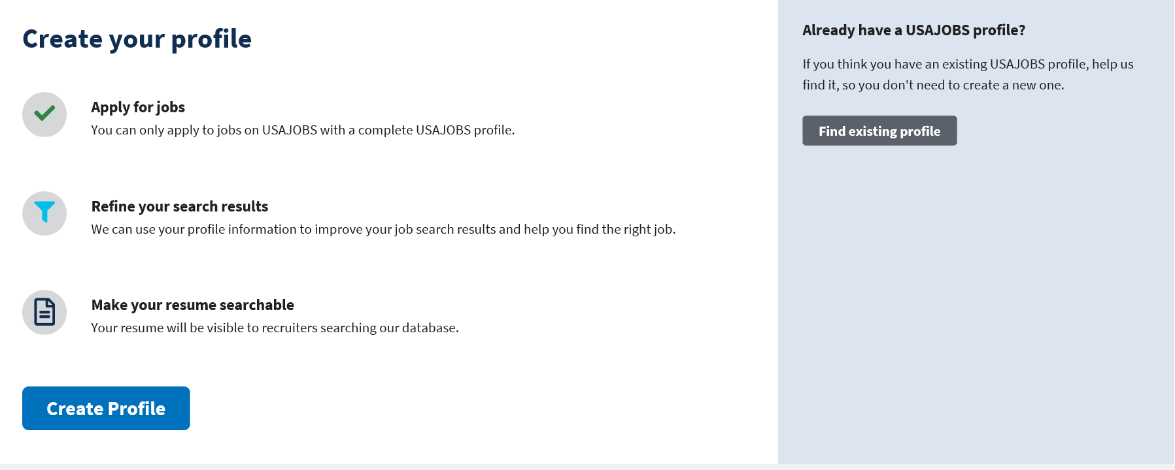
Find existing profile or create new

Slide 9
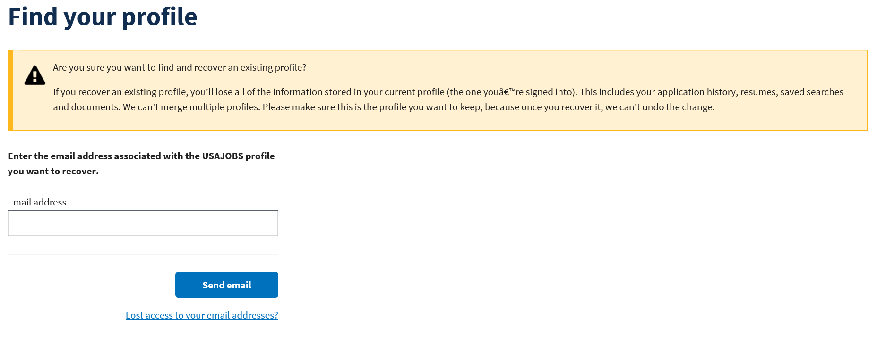
Find your profile

Slide 10
Create Profile Page for new users

Slide 11
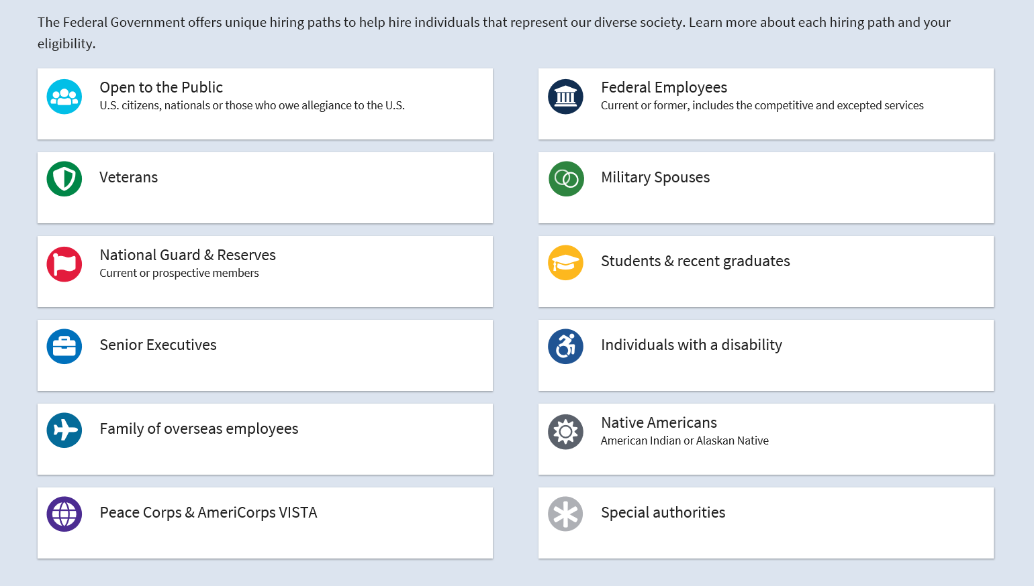
Tell us who you are
Select all that apply to you from the groups below.

Slide 12

How this works

Slide 13
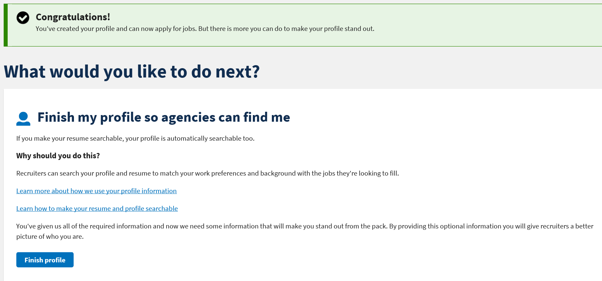
Finish my profile page

Slide 14
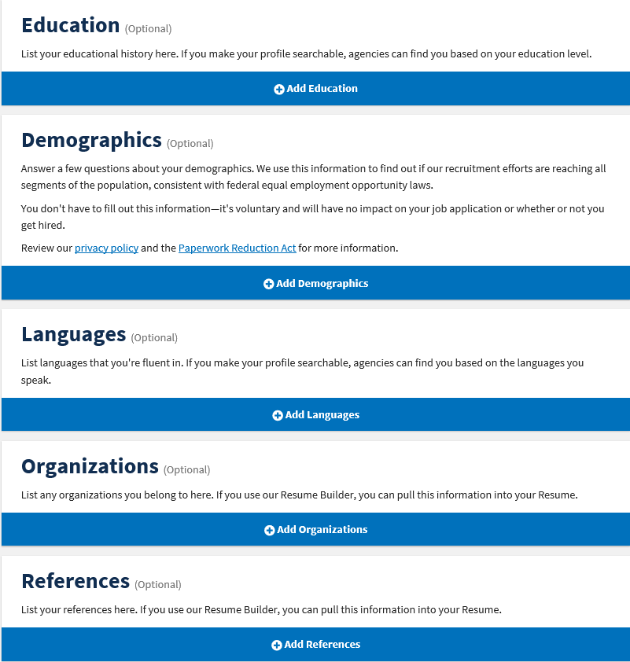
Categories page

Slide 15

Uploading / Building a Resume

Slide 16
Question 2
What information should you not include on your resume?
  Click for - Address
  Click for - References
  Click for - SSN

Slide 17
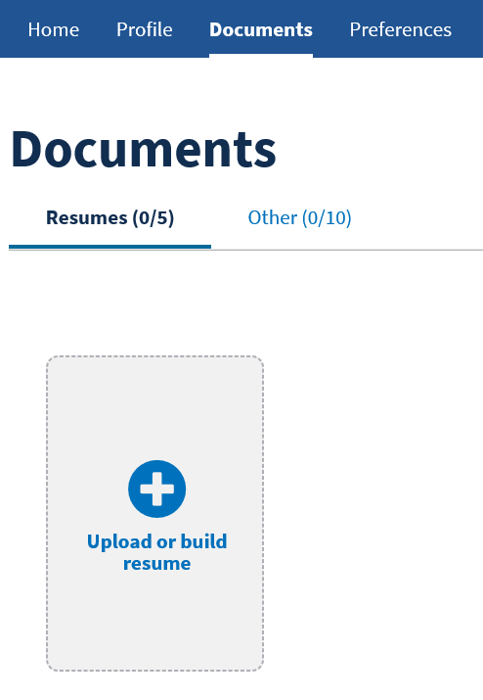
Uploading or Building a Resume
Under the documents tab, select “Upload or build resume”
You will be able to upload an existing resume, or build a new one within USAJOBS

Slide 18

Build or Upload a Resume

Slide 19
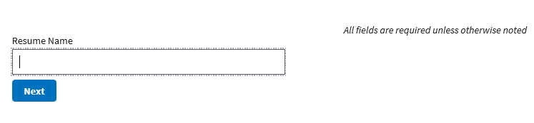
Resume Builder (step 1)

Slide 20
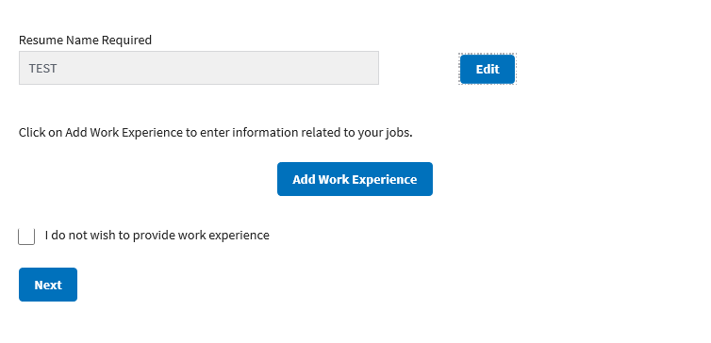
Resume Builder (step 2)

Slide 21
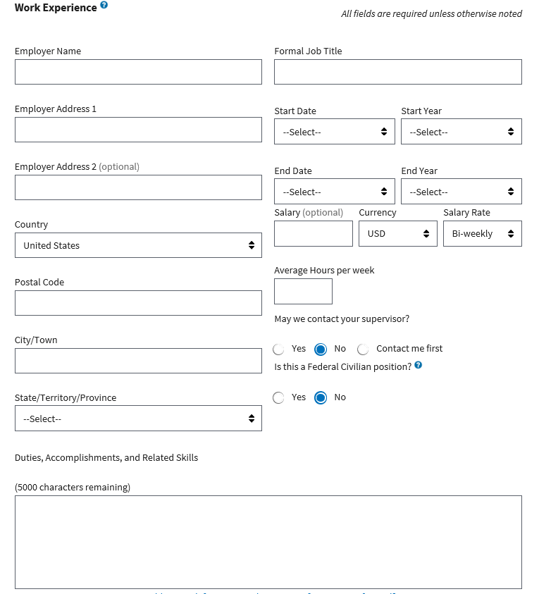
Adding a work experience

Slide 22
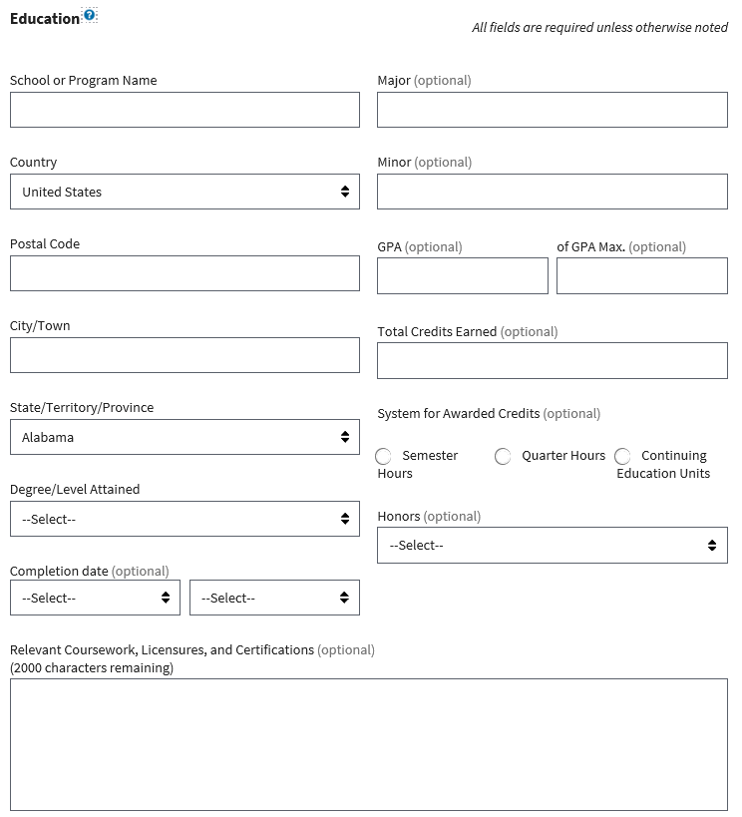
Add Education Screen

Slide 23
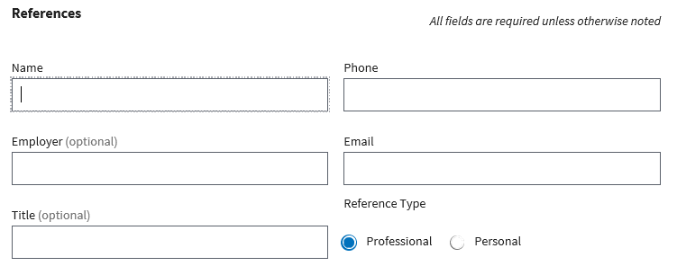
Enter References

Slide 24
Resume Tips
Tailor your resume to job announcement
  Create separate resumes for each position
Numbers impress hiring managers
  Highlight performance metrics
Sell yourself and your achievements

Slide 25
Resume Tips (Cont.)
Make resume searchable
  Only 1 resume searchable at a time
  Accepted file types:
    .doc/.docx,
    PDFs,
    text files, and
    resumes built on USAJOBS)
DO NOT include:
  Classified/sensitive information
  SSN
  Photos
  Personal Information (age, gender, religion, etc.)
  Encrypted/digitally signed documents

Slide 26
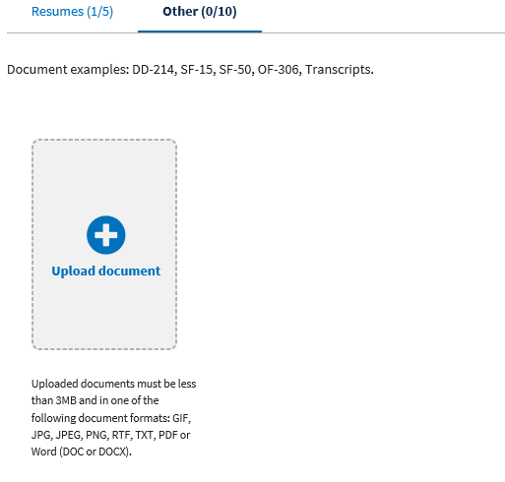
Documents (Other)

Slide 27
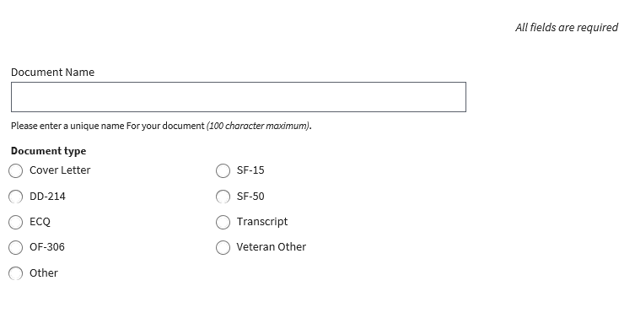
Add Document

Slide 28
Applying for Positions
Search for positions by keywords and/or location
Select position you are interested in
Submit resume and required documents
Sent to agency site to complete application

Slide 29
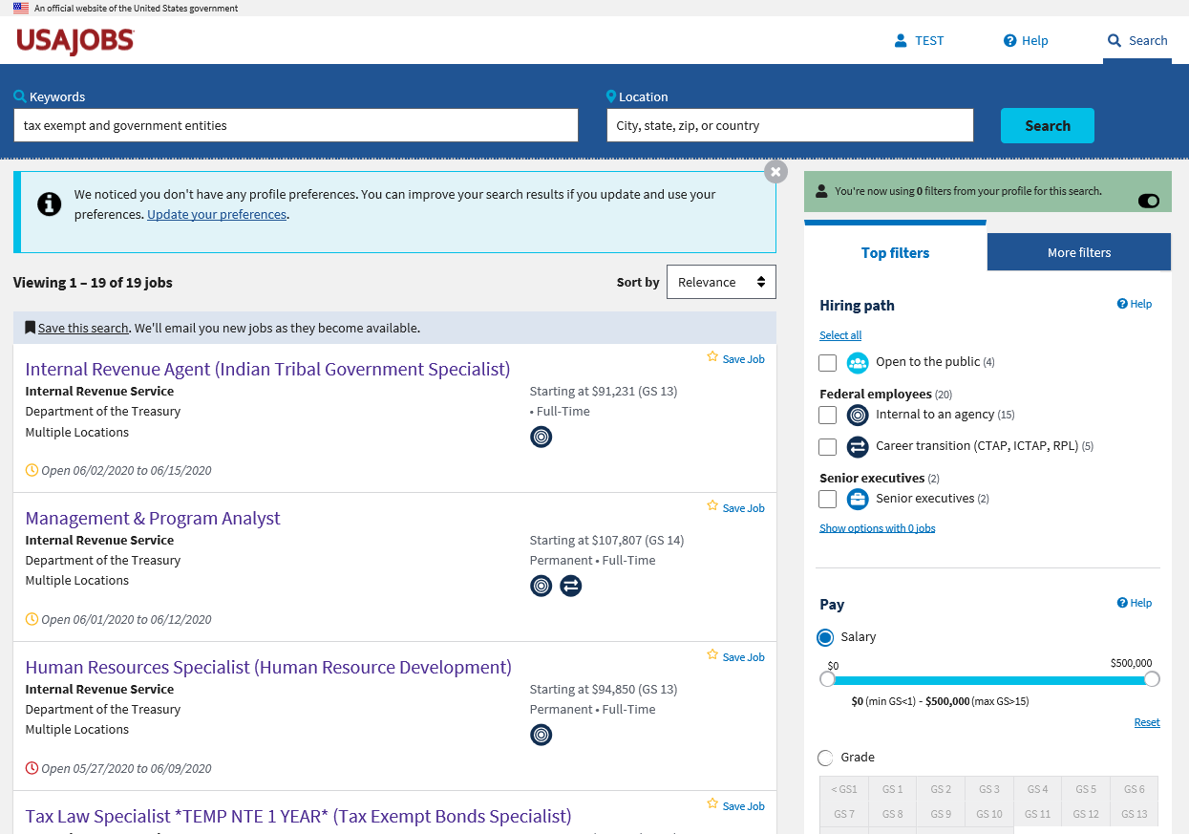
Job Announcement Page

Slide 30
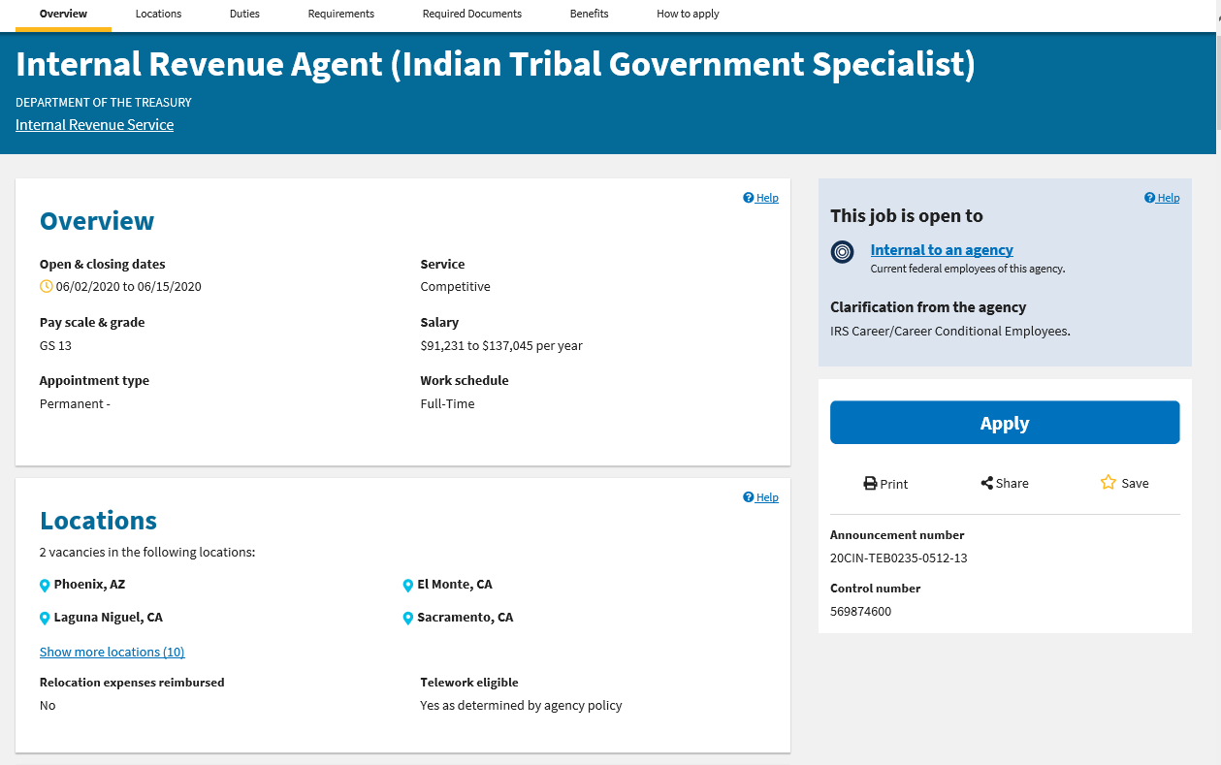
Position overview

Slide 31
Duties
Summary
WHAT IS THE TAX EXEMPT AND GOVERNMENT ENTITIES (TEGE) DIVISION? Tax Exempt & Government Entities Division serves Employee Plans which examines the returns of qualified pension benefit plans compliance. Exempt Organizations ensures not-for-profit organizations meet tax-exempt status requirements and Government Entities ensures organizations meet their tax withholding and employment tax payment requirements.
See Other Information for Locations
Responsibilities
WHAT DOES AN INTERNAL REVENUE AGENT, INDIAN TRIBAL GOVERNMENT SPECIALIST DO? As an Internal Revenue Agent, Indian Tribal Government Specialist, you will be responsible for providing technical and analytical services to the Indian Tribal Government examination program and outreach activities. The work of the position includes insuring that customers are provided with efficient and effective assistance in helping them to understand and comply with applicable tax laws, and that compliance actions are conducted in accordance with applicable tax law and IRM requirements.
Learn more about this Agency

Slide 32
Responsibility Details
As an Indian Tribal Government Specialist Internal Revenue Agent you will:
  Conduct compliance and outreach contacts, of large Tribal Governmental entities a with several operating subdivisions
  Identify previously unknown potential areas of non-compliance requiring legal interpretations to promote voluntary compliance
  Organize and conduct examinations of other kinds of tax returns and special examinations.
  Conduct and coordinate taxpayer education and outreach programs for Indian Tribal audiences, to foster voluntary compliance.
  Apply a comprehensive knowledge of the Internal Revenue Code, U. 5. Code Title 25, Indian Tribal Law, applicable treaties, to determine the correct tax liability to achieve voluntary compliance.
  Confer with Indian Tribal Government officials, tribal members, or representatives to explain the accounting and other issues involved.
  Coordinate or conduct outreach seminars providing refresher training to other Agents.

Slide 33
Requirements
Condition of Employment
Refer to Other Information.
Click “Print Preview” to review the entire announcement before applying.
Must be a U.S. Citizen or National.
IRS Employees with Career or Career Conditional Appointments
Qualifications
You must meet the following requirements by the closing date of this announcement.
BASIC REQUIREMENTS FOR ALL GRADES: A Bachelor's or higher degree in accounting with at least 30 semester hours (45 quarter hours) in accounting or 24 semester hours in accounting and an additional 6 semester hours in related subjects such as business law, economics, or finance. OR
A combination of experience and education equivalent to a four year degree that included courses equivalent to a major in accounting, OR
A Certificate as a Certified Public Accountant {CPA) obtained through written examination. OR
Was previously an Internal Revenue Agent GS-0512 and held the position for at least one year. AND
You must possess the following professional accounting knowledge's: Principles of Accounting, Intermediate Accounting, Cost Accounting, Advanced Accounting, and Auditing. For more information on the required accounting knowledges please refer to Internal Revenue Agent Basic Requirements
If not from an academic environment, the knowledge can also be obtained from certain work experience.

Slide 34
In addition to the above, you must meet the requirement described below
GS-13 LEVEL: You must have one year of specialized experience at a level of difficulty and responsibility equivalent to the GS-12 grade level in the Federal service. Specialized experience for this position includes: progressively responsible accounting or auditing work that required 1) knowledge of and experience applying professional accounting principles, theory, and practices to analyze and interpret accounting books, records, or systems specifically to determine their effect on Federal tax liabilities relating to governmental entities; 2) experience interpreting and applying Federal tax law for individuals, business, and /or exempt organization, partnerships and corporations; 3} knowledge of and experience interpreting business and trade practices to develop tax issues based on analysis and evaluation of overall business operations and financial condition; 4) knowledge of and experience analyzing corporate financial transactions and financial management principles and practices; 5) experience should demonstrate a knowledge of IRC, regulations, procedures, published rulings, and court decisions relating to income tax, employment tax, excise tax, and information reporting; and 6) skill in interacting effectively with a broad range of individuals and in negotiating with specialists in accounting, legal, tax and other similar business-related professions.
- The experience may have been gained in the public sector, private sector or Volunteer Service. One year of experience refers to full-time work; part-timework is considered on a prorated basis.
- To ensure full credit for your work experience, please indicate dates of employment by month/ year, and indicate number of hours worked per week, on your resume.
In addition to the above requirements, you must meet the following: You must have been at the GS-12 level for 52 weeks {time-in-grade requirement).

Slide 35
Additional Information
Two (2) Positions are located in Tax Exempt and Government Entities, Indian Tribal Governments, to be filled in any of the following locations: Ogden City Centre, 2484 S Washington Blvd., Ogden, UT (UT1431); or Jackson FB-Seattle, 915 Second Avenue, Seattle, WA (WA0101); or Central Plaza, 4041 N Central Ave, Phoenix, AZ (AZ7748); or Lakewood Business Park Bldg IV, 2850 NE Independence Ave., Lee's Summit, MO (M02008).
POSITION DESCRIPTION: PD 92981
A PM/C SharePoint site is available for 1RS Employees at:
httPs://or£anization.ds.irsnet.gov/sites/HCOETS/PMC/SPDLibrarv/SitePages/Home.aspx
CONDITIONS OF EMPLOYMENT:
We may select from this announcement or any other source to fill vacancies.
This is a bargaining unit position.
Relocation: NO
Alternative work schedule or telework may be available.
Must meet 1RS telework eligibility requirements.
Tour of Duty: Monday - Friday, 8:00 a.m. - 4:30 p.m.
The employment of any candidate, selected for this position may be conditional upon audit of up to 2 years federal tax returns.

Slide 36
How You Will Be Evaluated
You will be evaluated for this job based on how well you meet the qualifications above.
Application includes your resume, responses to online questions, and required supporting documents. Please be sure that your resume includes details to support your qualifications for this position; failure to provide sufficient evidence in your resume may result in a “not qualified" determination.
Rating: Your application will be evaluated on the CJEs of the position to be filled per the National Agreement Article 13. Your application will also be ranked among others, based on your responses regarding your experience, education, training, performance appraisals and awards relevant to the duties of this position. 1RS employees may obtain most recent awards listing at https://persinfo.web.irs.gov/. Your rating may be lowered, if your responses to the online questions are not supported by the education and/or experience described in your application.
Referral: If you are among the top qualified candidates, your application may be referred to a selecting official for consideration. You may be required to participate in a selection interview. We will not reimburse costs related to the interview. If you are a displaced or surplus employee eligible for Career Transition Assistance Plan (CTAP), you must score 80 or better to receive special selection priority.
To preview questions please click here.
Close
Background checks and security clearance
Security clearance – Not Required Drug test required - No

Slide 37
Required Documents
A complete application includes 1. A resume, 2. Vacancy question responses, and 3. Submission of any required documents. Please note that if you do not provide all required information you will not be considered for this position.
All applicants are required to submit a resume either by creating one in USAJOBS or uploading one of their own choosing. (Cover letters are optional). To receive full credit for relevant experience, please list the month/year and number of hours worked for experience listed on your resume. Please view Resume Tips
Career Transition Assistance Plan (CTAP) DOCUMENTATION: If you are a displaced or surplus Treasury employee, click ÇTAP for eligibility and a detailed list of required documents. 1RS CTAP eligible can apply for jobs within and outside the commuting area.
IRS Reassignment Preference Program (RPP): You must meet the requirements in your RPP notice. Submit a copy of your RPP Notice along with a copy of your most recent annual performance appraisal. Your performance appraisal must have a fully successful or higher overall rating.
PERFORMANCE APPRAISAL/AWARDS: Submit a copy of most recent performance appraisal.
IRS employees: If a revalidated appraisal is used for merit promotion, the supervisor must prepare a narrative for each critical job element that does not have a narrative describing the performance.
EDUCATION DOCUMENTATION: If you are qualifying for this position by substituting education or training for experience, submit a copy of your transcripts or equivalent. If the position has specific education requirements and you have previously been in the Federal job series to be filled, there is no need to submit a transcript or equivalent at this time. An official transcript will be required if you are selected. For a list of schools which meet these criteria, please refer to Department of Education Accreditation page. Refer to the OPM instructions.

Slide 38
Apply button

Slide 39
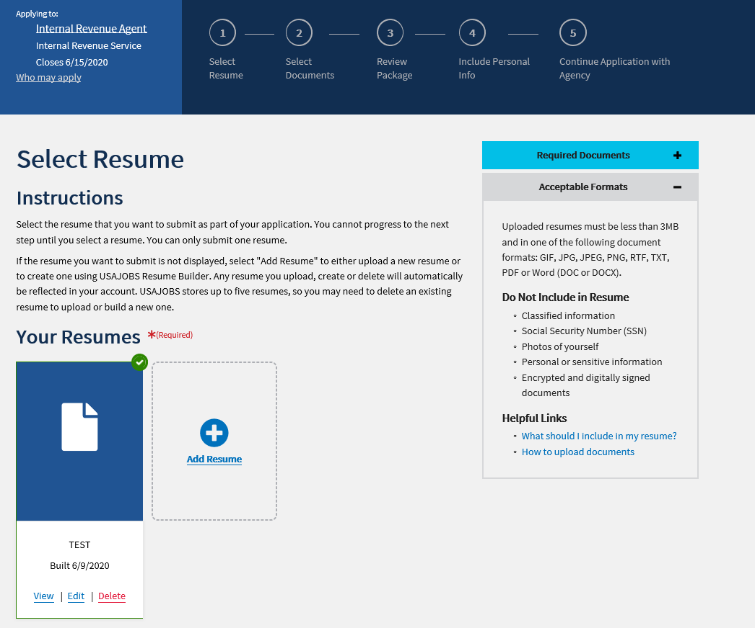
Select resume page

Slide 40
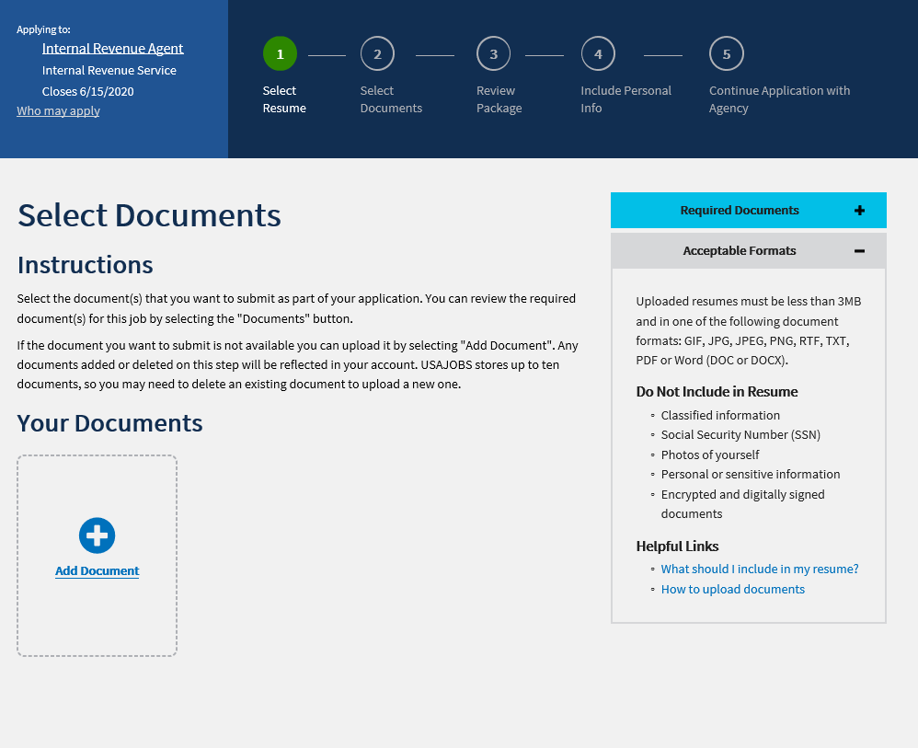
Select Documents page

Slide 41
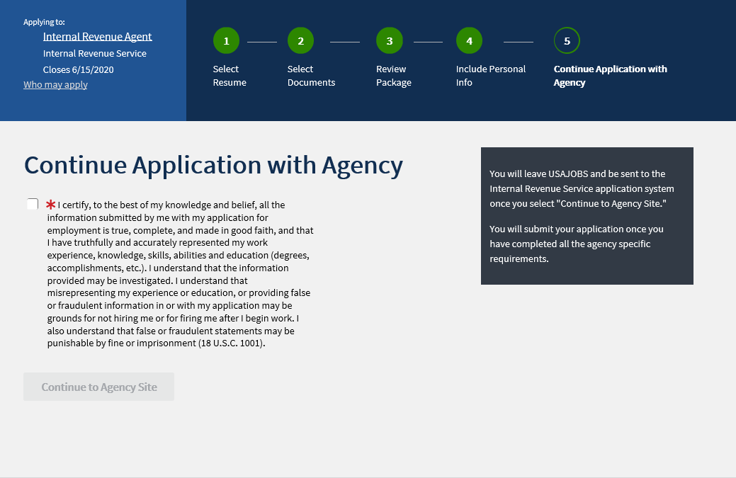
Continue Application Certification

Slide 42
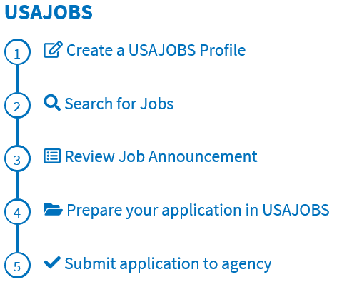
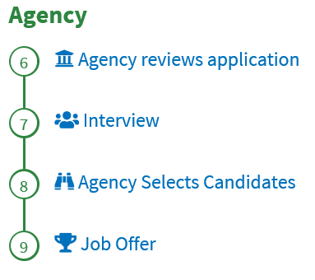
Applying for Positions - flow
Transition to Agency

Slide 43

Upcoming Events

Slide 44
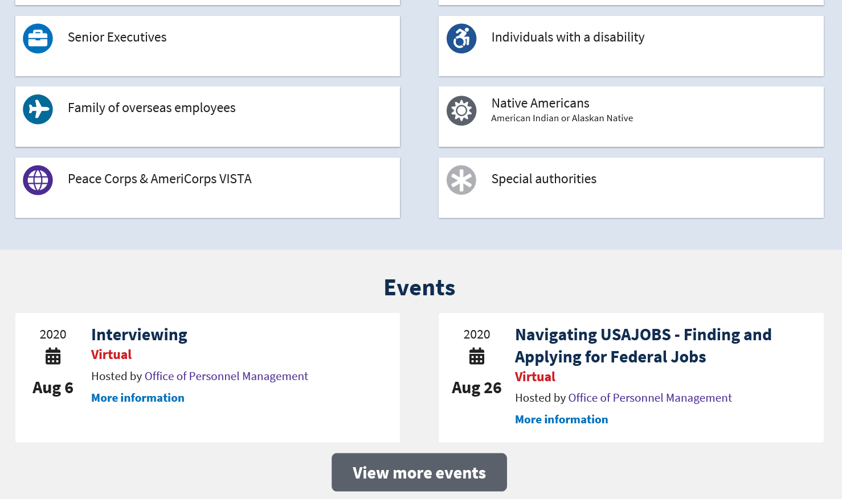
Upcoming events (Cont.)

Slide 45
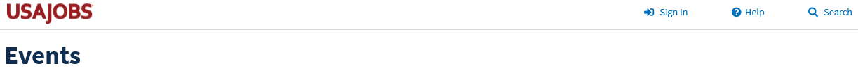
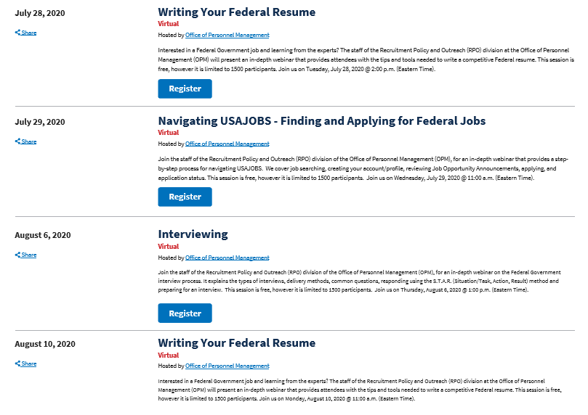
Listing of more events

Slide 46

Questions?

Slide 47
Points of Contact
Donisha Hines
  Donisha.A.Hines@irs.gov
Matthew Solano
  Matthew.P.Solano@irs.gov

